Slide 1
VIETNAM - KOREA UNIVERSITY OF INFORMATION AND COMMUNICATION TECHNOLOGY DEPARTMENT OF COMPUTER SCIENCE
BASIC PROJECT 1
TOPIC: MEMORY-BOX
Students perform: NGUYỄN THỊ THÚY HOAN – 24IT074
Class: 24GIT1
Supervisor: TS. NGUYỄN ĐỨC HIỂN
Da Nang, June 2025

Slide 2
CONTENTS
OVERVIEW INTRODUCTION
DESIGN ANALYSIS
EVALUATION
CONCLUSION

Slide 3
PART 1
OVERVIEW INTRODUCTION

Slide 4

INTRODUCTION TO THE SUBJECT
Reason for choosing the topic
“MemoryBox – A Digital Memory Keeper” was inspired by the need for a private space to store personal photos and notes without sharing them online.
Unlike apps like Google Photos or Instagram that focus on public sharing, MemoryBox allows users to save memories with images and personal notes in a simple, offline, and user-friendly desktop app.

Slide 5

INTRODUCTION TO THE SUBJECT
Describe the topic
MemoryBox lets users store personal photos and notes. It helps organize memories in one place.
Unlike social media, it keeps your memories private. No sharing, no distractions.
The app works offline. It’s simple, secure, and always accessible.
MemoryBox offers a calm, personal space. Perfect for reflection and emotional moments.

Slide 6


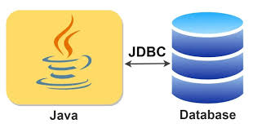


INTRODUCTION TO THE SUBJECT
Technology used
Java: mainly used for application logic and data processing.
JavaFx: a GUI toolkit with built-in components.
MySQL/SQL Server : database
Xampp : Supports localhost installation for the device.
Eclipse: an open-source IDE used mainly for Java development.

Slide 7

INTRODUCTION TO THE SUBJECT
Target
MemoryBox is a JavaFX desktop app for storing personal photos and notes securely. It provides a private space for memory keeping.
Unlike cloud apps, MemoryBox works completely offline. Users have full control over their data.
It uses Material Design and supports photo uploads, note-taking, search, and thumbnail views. Users can also customize themes and edit their profile.
All data is stored in a MySQL database. This ensures reliability and scalability.

Slide 8
PART 2
DESIGN ANALYSIS

Slide 9
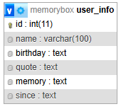
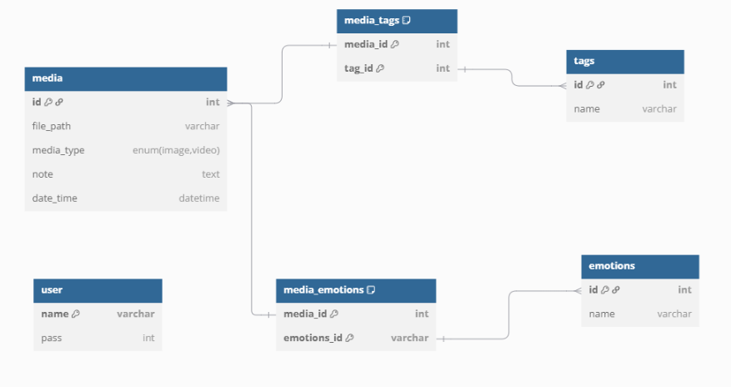
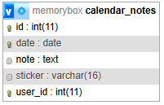
DESIGN ANALYSIS
Database

Slide 10
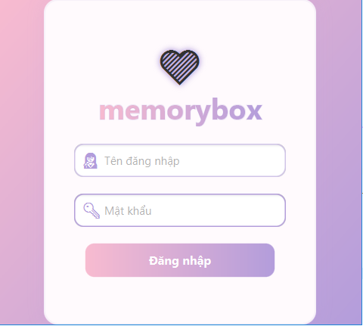
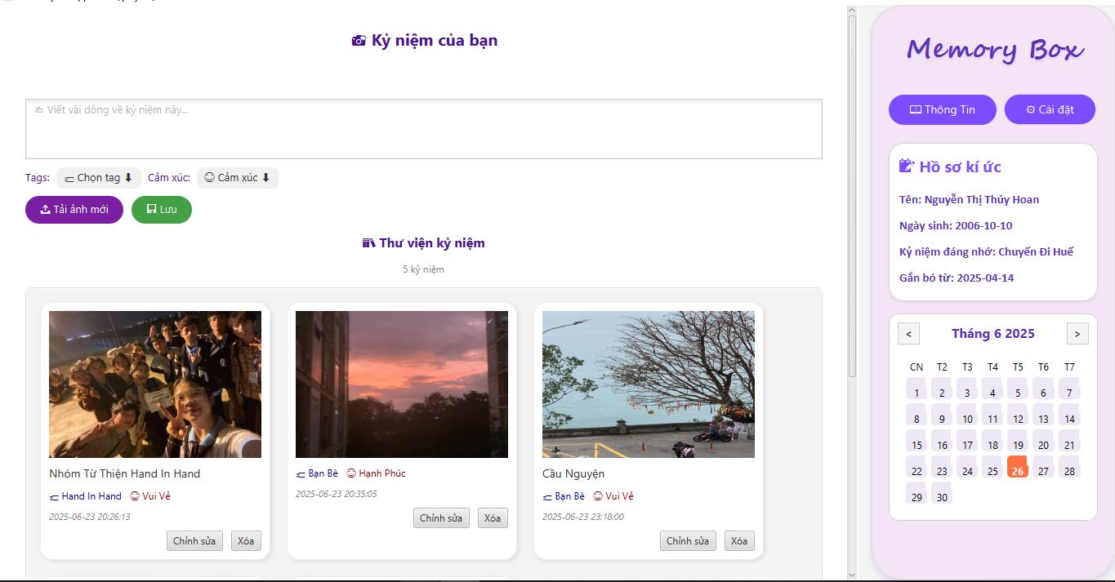
DESIGN ANALYSIS
Main functions of the system
Login to the app

Slide 11
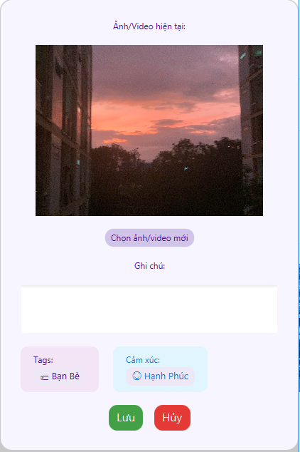
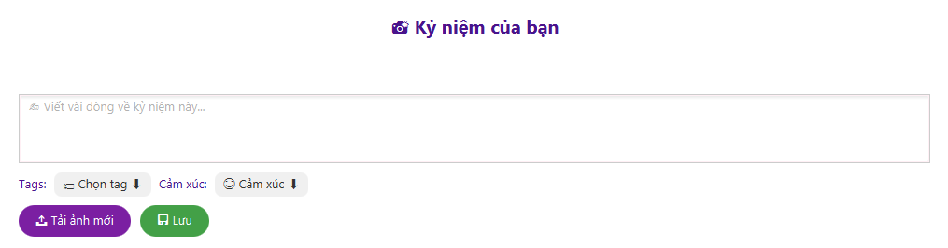
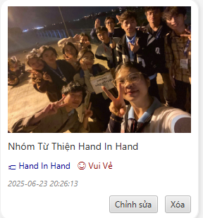
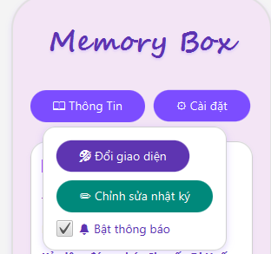
DESIGN ANALYSIS
Main functions of the system
Edit button

Slide 12
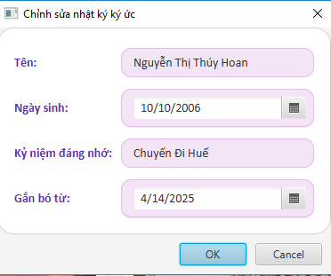
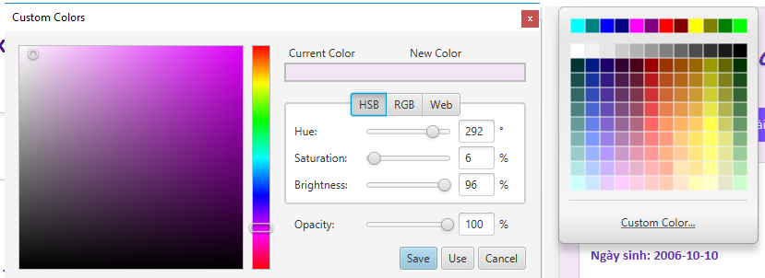
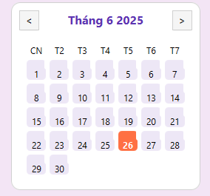
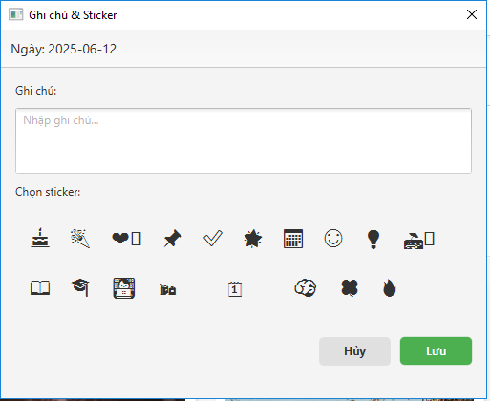
DESIGN ANALYSIS
Main functions of the system
Theme switch button

Slide 13
PART 3
EVALUATION

Slide 14
EVALUATION
Evaluate
Advantage:
The app features a modern and user-friendly interface built with JavaFX.
It supports photo and video uploads, note-taking, tagging, quick search, and theme customization.
These features make memory management simple, smooth, and personalized.
Disadvantage:
The app currently supports only a single user and does not sync across devices.
Performance may decrease when handling large photo or video files.
Security features such as encryption and multi-factor authentication are not yet available.

Slide 15

EVALUATION
Development directions and Solutions
Add multi-user support and cross-device syncing for flexibility.
Optimize performance to handle large media files smoothly.
Enhance security with encryption and multi-factor authentication.
Apply AI for auto-tagging and smart face recognition.
Introduce auto albums, social sharing, and cloud sync features.

Slide 16
PART 4
CONCLUSION

Slide 17
CONCLUSION
Achievements
The app has a modern, user-friendly interface built with JavaFX.
It supports photo/video uploads, notes, tagging, search, and themes.
These features make memory management easy and personal.
Limitations
Supports only one user and lacks multi-device syncing.
Performance may slow down with large media files.
No encryption or multi-factor authentication implemented yet.

Slide 18
THANK YOU
FOR WATCHING!

